Slide 1
An Introduction to Neo4j
Over the years, relational databases have become the proverbial hammer to the storage nail. Tables, rows, primary keys, foreign keys and the always loved SQL. Relational databases like SQL Server have their place, but when it comes to relationships, you can easily slip into a world of unnecessary complexity. Thankfully, there is a better way - graph databases. Neo4j is the most popular graph database in use today. In this session, we'll discuss the basics of graph databases, how to set up neo4j, create your first database and query using the cypher query language. You'll come out of this session with an understanding of why and how you'd use a graph database to solve real world problems.

Slide 2
An Introduction to Neo4j
The Kansas City Developer Conference
June 25, 2015
Michael Eaton / @mjeaton
Notes:
Welcome to this introduction to Neo4j.
My name is Michael Eaton,

Slide 3































Titanium Sponsors
Platinum Sponsors
Gold Sponsors

Slide 4

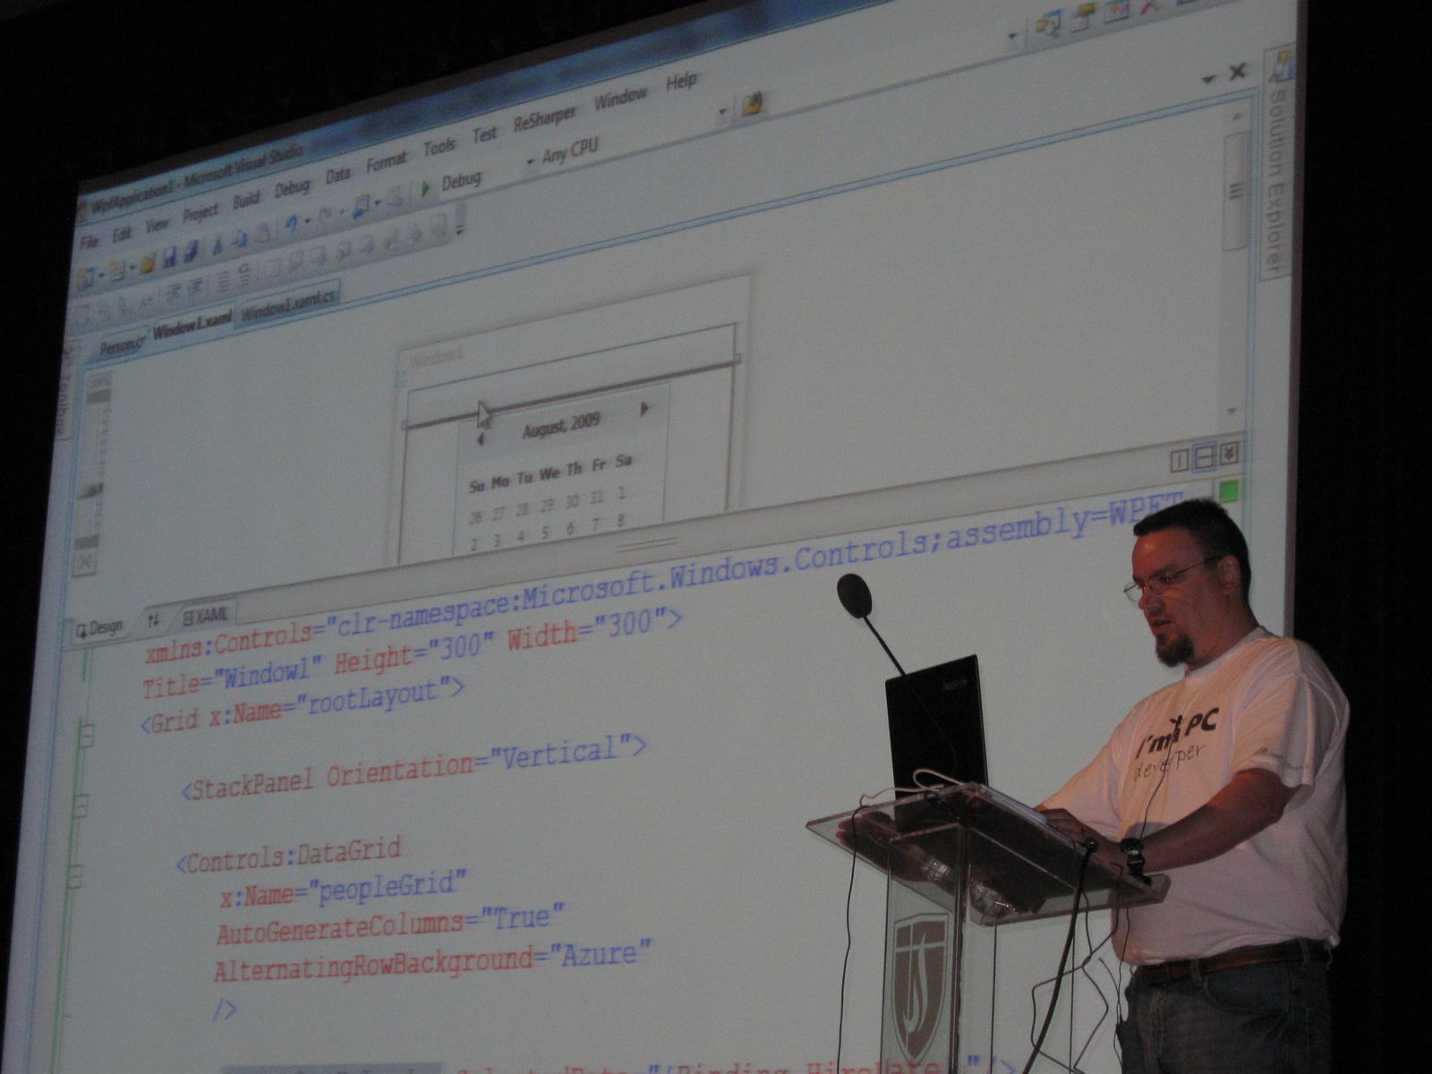
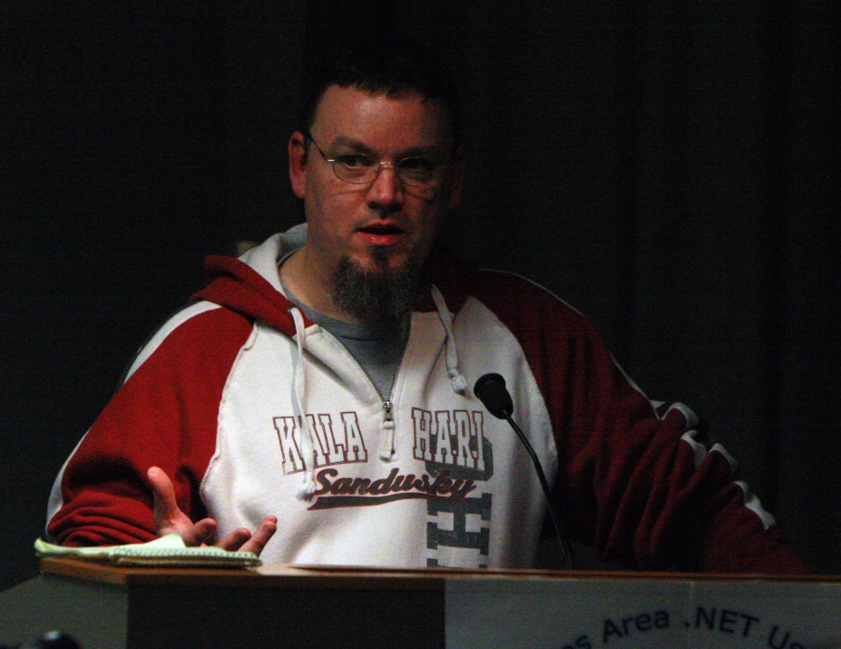
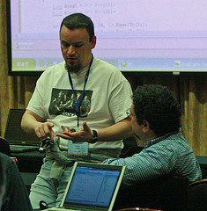

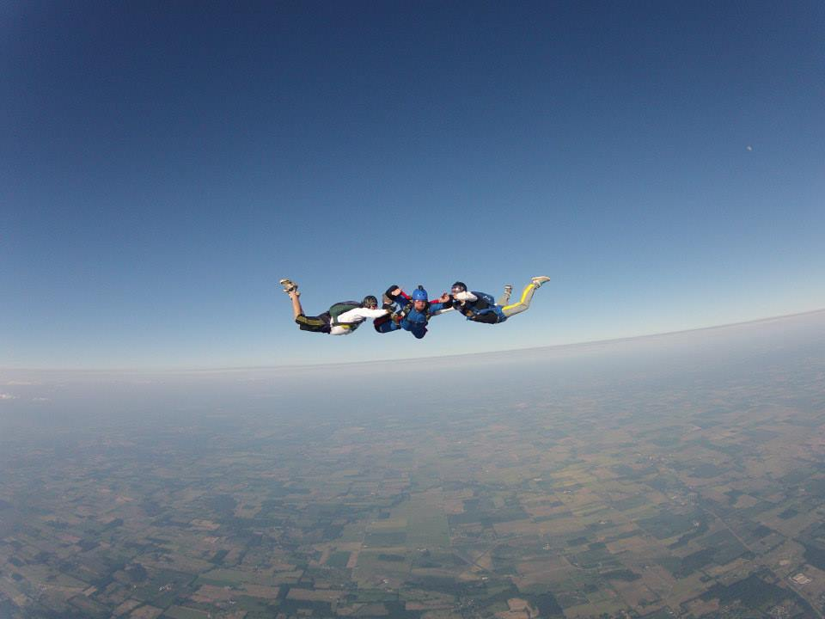

Slide 5

#1 Place to work in IT for the 3rd year in a row! http://bit.ly/quickenLoans1
We’re hiring! Interested? Let me know! @mjeaton / mikeeaton@quickenloans.com

Slide 6
about.me/mjeaton
Notes:
About.me/mjeaton

Slide 7
Disclaimer: Enthusiast, not expert
NOT a mathmetician!
Notes:
About.me/mjeaton

Slide 8
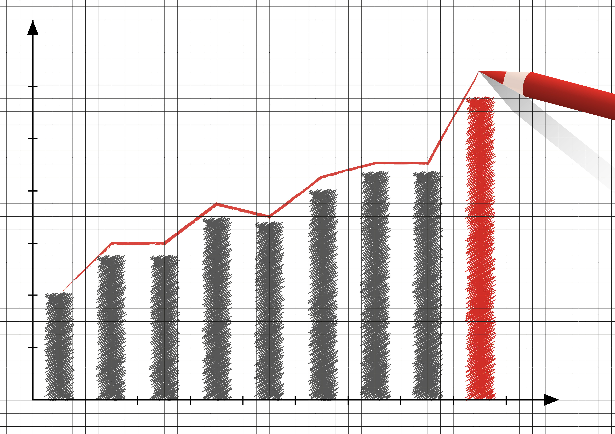
Graphs?

Slide 9

Graphs
Notes:
Relationships

Slide 10
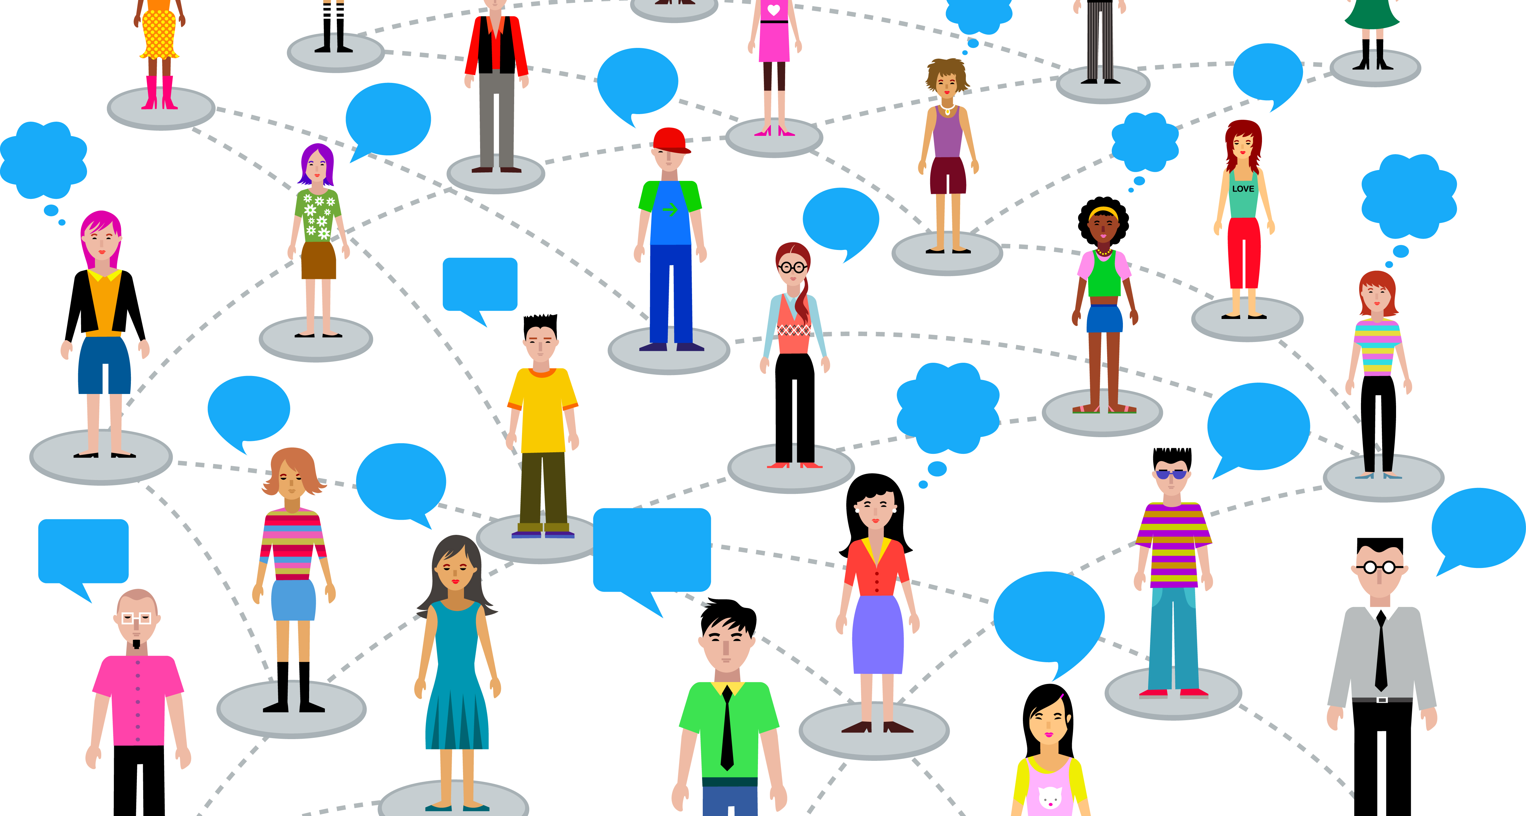

Slide 11
mike
jeff
lee
jon
follows
follows
follows
Notes:
What we’ll be talking about

Slide 12
Graph theory
Vertex
Vertex
Vertex
Vertex
Edge
Edge
Edge
Notes:
graph theory is the study of graphs, which are mathematical structures used to model relations between objects.

Slide 13
Graph theory
Node
Node
Node
Node
Relationship
Relationship
Relationship
Notes:
What we’ll be talking about

Slide 14
Nosql
NoSQL DB
Graph
Key-Value Pair
Column
Document
Is_type_of
Is_type_of
Is_type_of
Is_type_of
Is_type_of
Notes:
Nosql databases
A NoSQL (often interpreted as Not only SQL^{[1][2]}) database provides a mechanism for storage and retrieval of data that is modeled in means other than the tabular relations used in relational databases.

Slide 15
Graph databases
Graph DBs
Allegro Graph
Graph Engine
Neo4j
* Many, manymore
Orly
Infinite Graph
Is_a
Is_a
Is_a
Is_a
Is_a
Is_a
Notes:
Graph theory

Slide 16
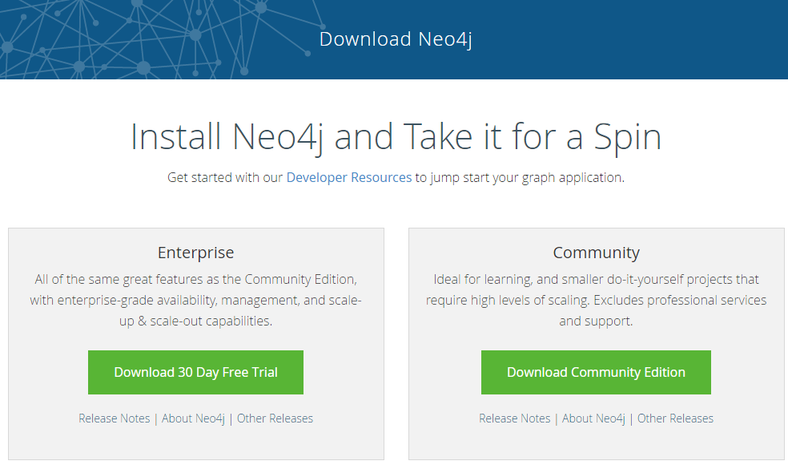
installing

Slide 17

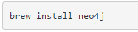
installing

Slide 18
browser
Notes:
Installing Neo4j

Slide 19
browser
Notes:
Installing Neo4j

Slide 20
cypher
Notes:
Neo4j browser

Slide 21
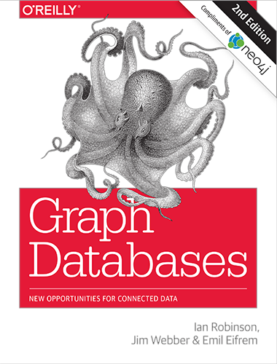


More information - Books
Notes:
Cypher

Slide 22
More information - links
http://neo4j.com
http://watch.neo4j.com
http://neo4j.com/graphacademy/online-training/
http://pluralsight.com (Intro by Roland Guijt)
https://github.com/Readify/Neo4jClient
http://neo4j.com/developer/language-guides/
http://gist.neo4j.org/
https://twitter.com/neo4j
Notes:
Cypher

Slide 23
about.me/mjeaton

Slide 24
Image credits
Map of Königsberg - https://commons.wikimedia.org/wiki/File:Konigsberg_bridges.png
Bridges - https://commons.wikimedia.org/wiki/File:7_bridges.svg
Königsberg Graph - https://commons.wikimedia.org/wiki/File:K%C3%B6nigsberg_graph.svg

Slide 25
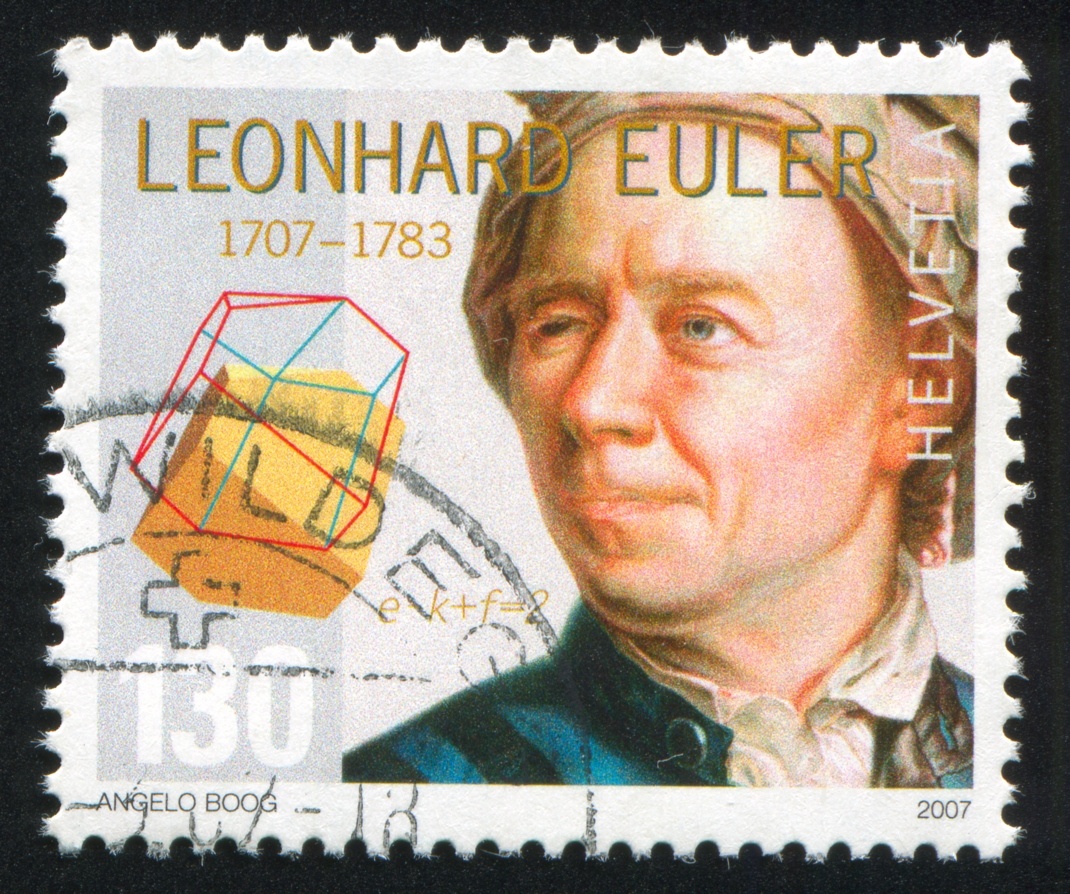

Slide 26

Seven bridges problem
Notes:
The problem was to devise a walk through the city that would cross each bridge once and only once, with the provisos that: the islands could only be reached by the bridges and every bridge once accessed must be crossed to its other end. The starting and ending points of the walk need not be the same.

Slide 27
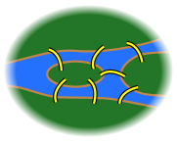
Seven bridges problem
Notes:
First, Euler pointed out that the choice of route inside each land mass is irrelevant. The only important feature of a route is the sequence of bridges crossed. This allowed him to reformulate the problem in abstract terms (laying the foundations of graph theory), eliminating all features except the list of land masses and the bridges connecting them. In modern terms, one replaces each land mass with an abstract "vertex" or node, and each bridge with an abstract connection, an "edge", which only serves to record which pair of vertices (land masses) is connected by that bridge. The resulting mathematical structure is called a graph.

Slide 28
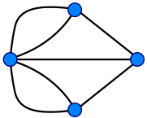
Seven bridges problem
Notes:
Since only the connection information is relevant, the shape of pictorial representations of a graph may be distorted in any way, without changing the graph itself. Only the existence (or absence) of an edge between each pair of nodes is significant. For example, it does not matter whether the edges drawn are straight or curved, or whether one node is to the left or right of another.

